Slide 1

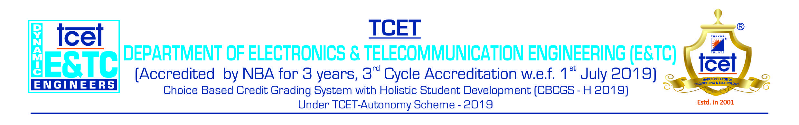
Human Resource Management
(Institute Elective Subject –BE Sem VII)
Module-1
Interdisciplinary approach
&
Competency of HR Manager
Cdr. Vijay Pratap Singh, Adjunct Professor, E&TC dept

Slide 2
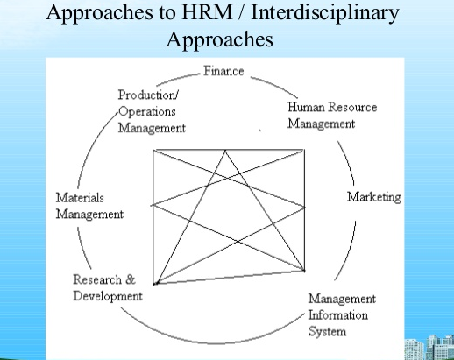

Slide 3
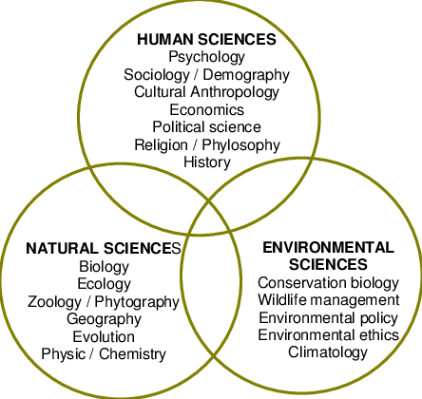
Interdisciplinary Approach

Slide 4
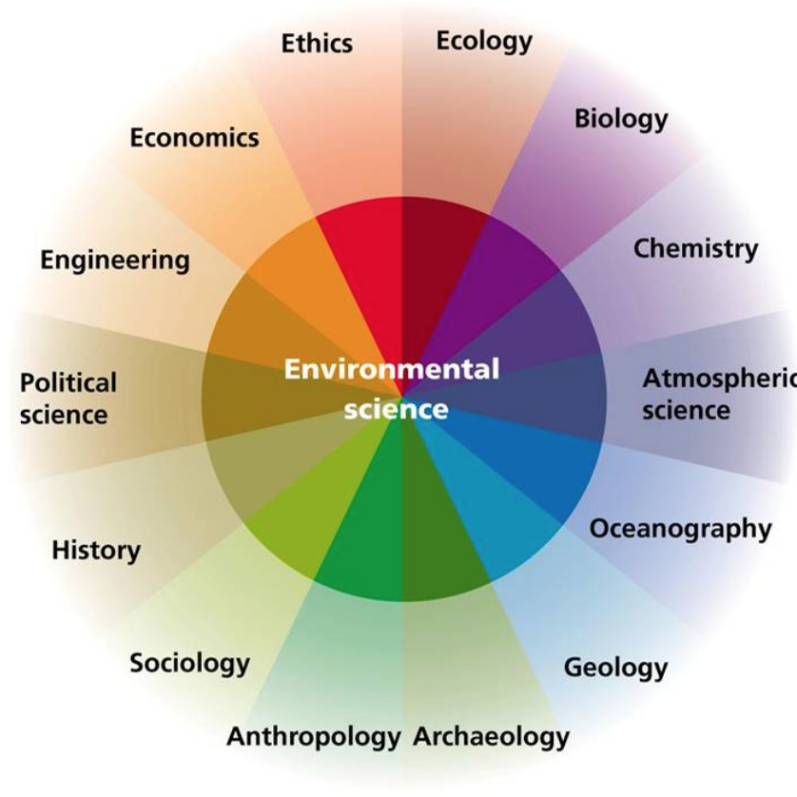
Interdisciplinary Approach

Slide 5
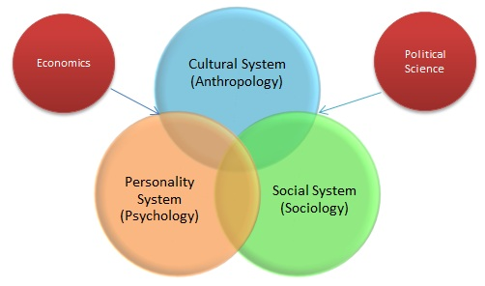
Multidisciplinary Approach in HR Management

Slide 6
Competencies of HR Managers
Personal attributes: He should be familiar with human needs, wants, hopes and desires, values and aspirations. He should possess attributes like:
Intelligence
Learning and Coaching skills
Discrimination skills
Leadership skills
Executing skills

Slide 7
Competence & Proficiencies of HR Manager
Experience and training: Previous experience and also training in psychological aspects of human behavior, personnel management is an additional benefit.
Professional attitude: He should have patience and understanding and the ability to listen before offering advice. Knowledge of various disciplines.
Ethical attitudes and legal compliance: Ethics is the code of moral principles and values that govern the behavior of a person or group with respect to what is right or wrong. Eg. Satyam Computers, Enron etc.

Slide 8
HR Managers proficiencies and qualifications
Qualifications:
In expanding list of tasks, makes the search for a suitable candidate rather challenging.
Degree from a recognized University
Postgraduate degree/diploma in HRM/ HRS/ Labour Welfare
Degree in Law
Knowledge of local language

Slide 9
HR Managers proficiencies and qualifications
Well defined body of knowledge: IIM, IGNOU, AIMA, XLRI, NIPM etc.
Formal education and training: Formal degree from a premier management institute in the form of MBA,MA or MSW or master programme in HR.
Minimum qualification

Slide 10
Q & A session

